Slide 1
Chapter 2 Elementary Programming

Slide 2
Motivations
Suppose, for example, that you need to take out a student loan. Given the loan amount, loan term, and annual interest rate, can you write a program to compute the monthly payment and total payment? This chapter shows you how to write programs like this. Along the way, you learn the basic steps that go into analyzing a problem, designing a solution, and implementing the solution by creating a program.

Slide 3
Objectives
To write programs that perform simple computations (§2.2).
To obtain input from a program’s user by using the input function (§2.3).
To use identifiers to name variables (§2.4).
To assign data to variables (§2.5).
To define named constants (§2.6).
To use the operators +, -, *, /, //, %, and ** (§2.7).
To write and evaluate numeric expressions (§2.8).
To use augmented assignment operators to simplify coding (§2.9).
To perform numeric type conversion and rounding with the int and round functions (§2.10).
To obtain the current system time by using time.time() (§2.11).
To describe the software development process and apply it to develop the loan payment program (§2.12).
To compute and display the distance between two points (§2.13).

Slide 4
Introducing Programming with an Example
Listing 2.1 Computing the Area of a Circle
This program computes the area of the circle.
IMPORTANT NOTE:
(1) To enable the buttons, you must download the entire slide file slide.zip and unzip the files into a directory (e.g., c:\slide). (2) You must have installed Python and set python bin directory in the environment path. (3) If you are using Office 2010, check PowerPoint2010.doc located in the same folder with this ppt file.
ComputeArea
Run

Slide 5
Trace a Program Execution
animation
Assign 20 to radius
# Assign a radius
radius = 20 # radius is now 20
# Compute area
area = radius * radius * 3.14159
# Display results
print("The area for the circle of radius " +
str(radius) + " is " + str(area))
radius
20

Slide 6
Trace a Program Execution
animation
Assign result to area
# Assign a radius
radius = 20 # radius is now 20
# Compute area
area = radius * radius * 3.14159
# Display results
print("The area for the circle of radius“,
radius, " is "area)
radius
20
area
1256.636

Slide 7
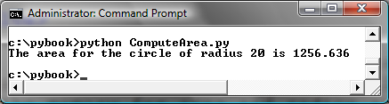
Trace a Program Execution
animation
print a message to the console
# Assign a radius
radius = 20 # radius is now 20
# Compute area
area = radius * radius * 3.14159
# Display results
print("The area for the circle of radius",
radius, "is", area)
radius
20
area
1256.636

Slide 8
Reading Input from the Console
1. Use the input function
  variable = input("Enter a string: ")
2. Use the eval function
  var = eval(stringVariable)
  eval("51 + (54 * (3 + 2))") returns 321.
ComputeAreaWithConsoleInput
ComputeAverage
Run
Run

Slide 9
Comments in Python
Anything after a # is ignored by Python
Why comment?
  Describe what is going to happen in a sequence of code
  Document who wrote the code or other ancillary information
  Turn off a line of code - perhaps temporarily

Slide 10
Identifiers/Variable Names
An identifier is a sequence of characters that consists of letters, digits, underscores (_).
An identifier must start with a letter or an underscore. It cannot start with a digit.
An identifier cannot be a reserved word. (See Appendix A, "Python Keywords," for a list of reserved words.) Reserved words have special meanings in Python, which we will later.
An identifier can be of any length.

Slide 11
Python Variable Name Rules
Must start with a letter or underscore _
Must consist of letters and numbers and underscores
Case Sensitive
Good: spam eggs spam23 _speed
Bad: 23spam #sign var.12
Different: spam Spam SPAM

Slide 12
Reserved Words
You can not use reserved words as variable names / identifiers
and del for is raise
assert elif from lambda return
break else global not try
class except if or while
continue exec import pass yield
def ﬁnally in print

Slide 13
Variables
A variable is a named place in the memory where a programmer can store data and later retrieve the data using the variable “name”
Programmers get to choose the names of the variables
You can change the contents of a variable in a later statement
x = 12.2
y = 14
12.2
x
100
x = 100
y
14

Slide 14
Variables
# Compute the first area
radius = 1.0
area = radius * radius * 3.14159
print("The area is ", area,
" for radius ", radius)
# Compute the second area
radius = 2.0
area = radius * radius * 3.14159
print("The area is ", area,
" for radius ", radius)

Slide 15
Expression
x = 1 # Assign 1 to variable x
radius = 1.0 # Assign 1.0 to variable radius
# Assign the value of the expression to x
x = 5 * (3 / 2) + 3 * 2
x = y + 1 # Assign the addition of y and 1 to x
area = radius * radius * 3.14159 # Compute area

Slide 16
Assignment Statements
We assign a value to a variable using the assignment statement (=)
An assignment statement consists of an expression on the right hand side and a variable to store the result
x = 3.9 * x * ( 1 - x )

Slide 17
A variable is a memory location used to store a value (0.6).
x
0.6
0.6
0.6
x = 3.9 * x * ( 1 - x )
0.4
Right side is an expression. Once expression is evaluated, the result is placed in (assigned to) x.
0.93

Slide 18
A variable is a memory location used to store a value. The value stored in a variable can be updated by replacing the old value (0.6) with a new value (0.93).
x
0.6 0.93
x = 3.9 * x * ( 1 - x )
Right side is an expression. Once expression is evaluated, the result is placed in (assigned to) the variable on the left side (i.e. x).
0.93

Slide 19
Assignment Statements
x = 1 # Assign 1 to x
x = x + 1
i = j = k = 1

Slide 20
Simultaneous Assignment
var1, var2, ..., varn = exp1, exp2, ..., expn
x, y = y, x # Swap x with y
ComputeAverageWithSimultaneousAssignment
Run

Slide 21
Named Constants
The value of a variable may change during the execution of a program, but a named constant or simply constant represents permanent data that never changes. Python does not have a special syntax for naming constants. You can simply create a variable to denote a constant. To distinguish a constant from a variable, use all uppercase letters to name a constant.

Slide 22
Numerical Data Types
integer: e.g., 3, 4
float: e.g., 3.0, 4.0

Slide 23
Several Types of Numbers
Numbers have two main types
  Integers are whole numbers: -14, -2, 0, 1, 100, 401233
  Floating Point Numbers have decimal parts: -2.5 , 0.0, 98.6, 14.0
There are other number types - they are variations on float and integer
>>> xx = 1
>>> type (xx)
<class 'int'>
>>> temp = 98.6
>>> type(temp)
< class 'float'>
>>> type(1)
< class 'int'>
>>> type(1.0)
< class 'float'>
>>>

Slide 24
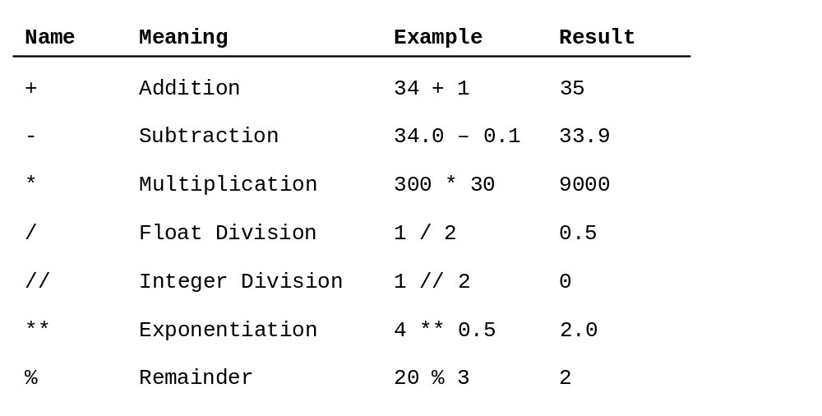
Numeric Operators

Slide 25
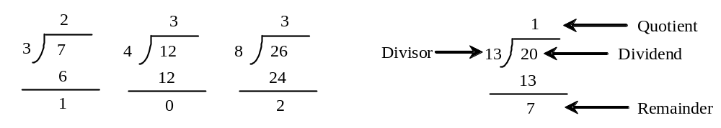
The % Operator

Slide 26

Remainder Operator
Remainder is very useful in programming. For example, an even number % 2 is always 0 and an odd number % 2 is always 1. So you can use this property to determine whether a number is even or odd. Suppose today is Saturday and you and your friends are going to meet in 10 days. What day is in 10 days? You can find that day is Tuesday using the following expression:

Slide 27
Problem: Displaying Time
Write a program that obtains hours and minutes from seconds.
DisplayTime
Run

Slide 28
Overflow
When a variable is assigned a value that is too large (in size) to be stored, it causes overflow. For example, executing the following statement causes overflow.
>>>245.0 ** 1000
OverflowError: 'Result too large'

Slide 29
Underflow
When a floating-point number is too small (i.e., too close to zero) to be stored, it causes underflow. Python approximates it to zero. So normally you should not be concerned with underflow.

Slide 30
Scientific Notation
- Floating-point literals can also be specified in scientific notation, for example,
- 1.23456e+2, same as 1.23456e2, is equivalent to 123.456, and
- 1.23456e-2 is equivalent to 0.0123456.
E (or e) represents an exponent and it can be either in lowercase or uppercase.

Slide 31

Arithmetic Expressions
is translated to
(3+4*x)/5 – 10*(y-5)*(a+b+c)/x + 9*(4/x + (9+x)/y)

Slide 32
Order of Evaluation
When we string operators together - Python must know which one to do first
This is called “operator precedence”
Which operator “takes precedence” over the others
x = 1 + 2 * 3 - 4 / 5 ** 6

Slide 33
Operator Precedence Rules
Highest precedence rule to lowest precedence rule
  Parenthesis are always respected
  Exponentiation (raise to a power)
  Multiplication, Division, and Remainder
  Addition and Subtraction
  Left to right
Parenthesis
Power
Multiplication
Addition
Left to Right

Slide 34
1 + 2 ** 3 / 4 * 5
>>> x = 1 + 2 ** 3 / 4 * 5
>>> print(x)
11
>>>
1 + 8 / 4 * 5
1 + 2 * 5
Parenthesis
Power
Multiplication
Addition
Left to Right
1 + 10
11

Slide 35
1 + 2 ** 3 / 4 * 5
>>> x = 1 + 2 ** 3 / 4 * 5
>>> print x
11
>>>
1 + 8 / 4 * 5
Note 8/4 goes before 4*5 because of the left-right rule.
1 + 2 * 5
1 + 10
Parenthesis
Power
Multiplication
Addition
Left to Right
11

Slide 36
Operator Precedence
Remember the rules top to bottom
When writing code - use parenthesis
When writing code - keep mathematical expressions simple enough that they are easy to understand
Break long series of mathematical operations up to make them more clear
Parenthesis
Power
Multiplication
Addition
Left to Right
Exam Question: x = 1 + 2 * 3 - 4 / 5

Slide 37
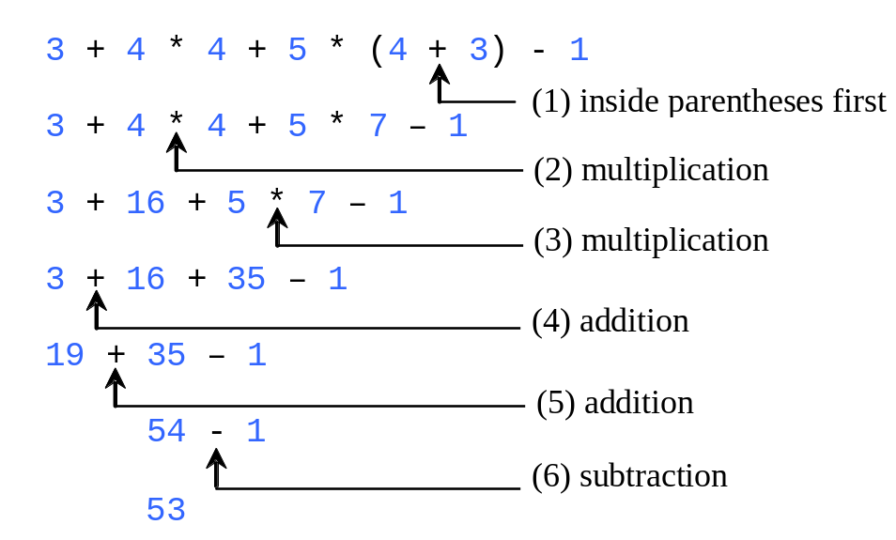
How to Evaluate an Expression
Though Python has its own way to evaluate an expression behind the scene, the result of a Python expression and its corresponding arithmetic expression are the same. Therefore, you can safely apply the arithmetic rule for evaluating a Python expression.

Slide 38
Mixing Integer and Floating
When you perform an operation where one operand is an integer and the other operand is a floating point the result is a floating point
The integer is converted to a floating point before the operation
>>> print (1 + 2 * 3 / 4.0 – 5)
-2.5
>>>

Slide 39
Augmented Assignment Operators
Operator Example Equivalent
+= i += 8 i = i + 8
-= f -= 8.0 f = f - 8.0
*= i *= 8 i = i * 8
/= i /= 8 i = i / 8
%= i %= 8 i = i % 8

Slide 40
Type Conversion and Rounding
datatype(value)
i.e., int(4.5) => 4
float(4) => 4.0
str(4) => “4”
round(4.6) => 5
round(4.5) => 4

Slide 41
Problem: Keeping Two Digits After Decimal Points
Write a program that displays the sales tax with two digits after the decimal point.
SalesTax
Run

Slide 42
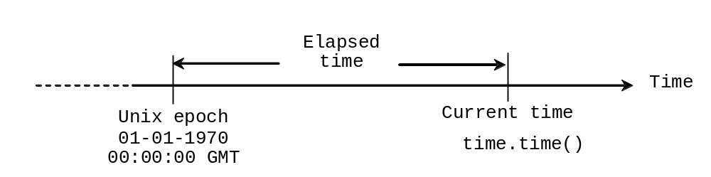
Problem: Displaying Current Time
Write a program that displays current time in GMT in the format hour:minute:second such as 1:45:19.
The time.time() function returns the current time in seconds with millisecond precision since the midnight, January 1, 1970 GMT. (1970 was the year when the Unix operating system was formally introduced.) You can use this function to obtain the current time, and then compute the current second, minute, and hour as follows.
ShowCurrentTime
Run

Slide 43
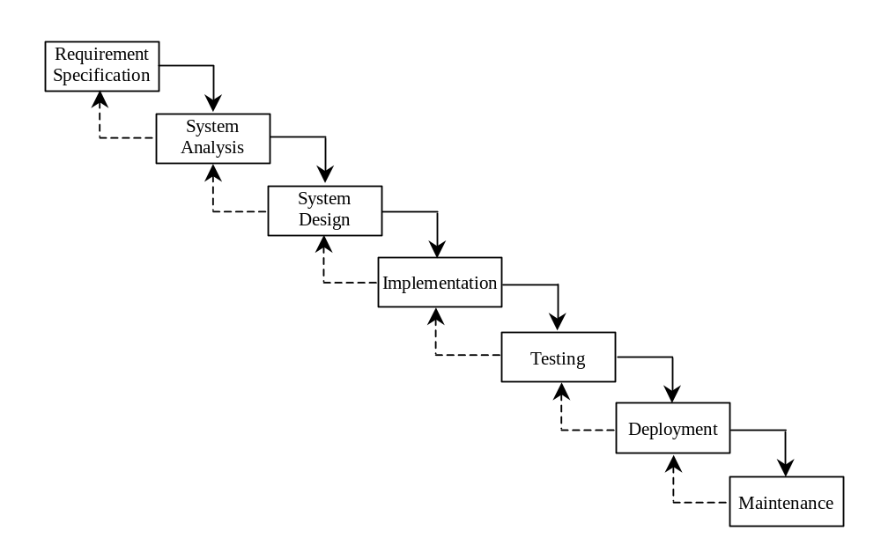
Software Development Process

Slide 44
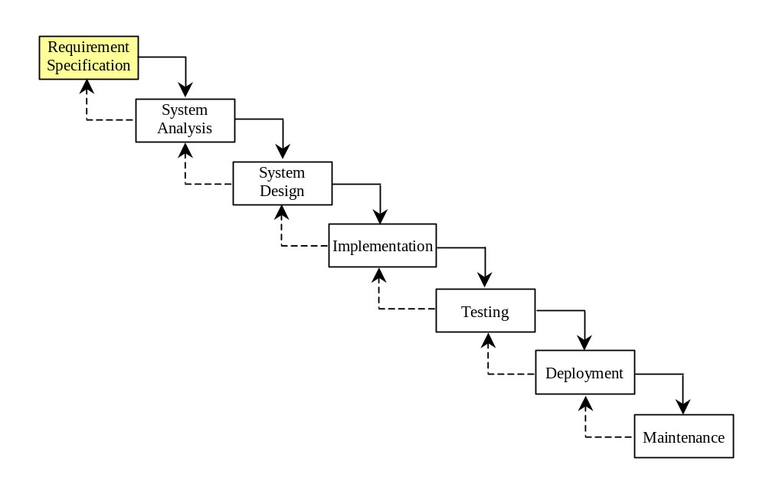
Requirement Specification
A formal process that seeks to understand the problem and document in detail what the software system needs to do. This phase involves close interaction between users and designers.
Most of the examples in this book are simple, and their requirements are clearly stated. In the real world, however, problems are not well defined. You need to study a problem carefully to identify its requirements.

Slide 45
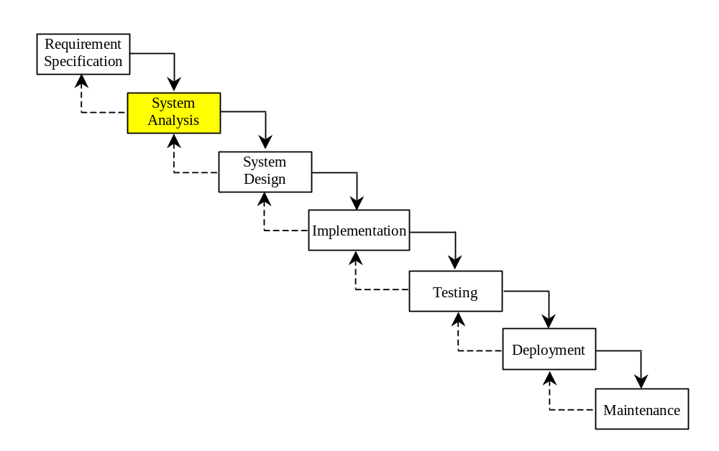
System Analysis
Seeks to analyze the business process in terms of data flow, and to identify the system’s input and output.
Part of the analysis entails modeling the system’s behavior. The model is intended to capture the essential elements of the system and to define services to the system.

Slide 46
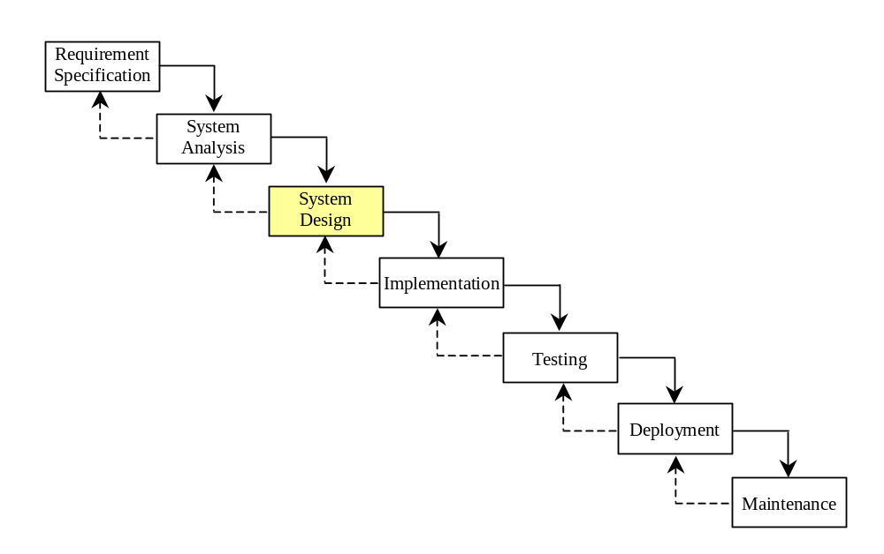
System Design
The process of designing the system’s components.
This phase involves the use of many levels of abstraction to decompose the problem into manageable components, identify classes and interfaces, and establish relationships among the classes and interfaces.

Slide 47
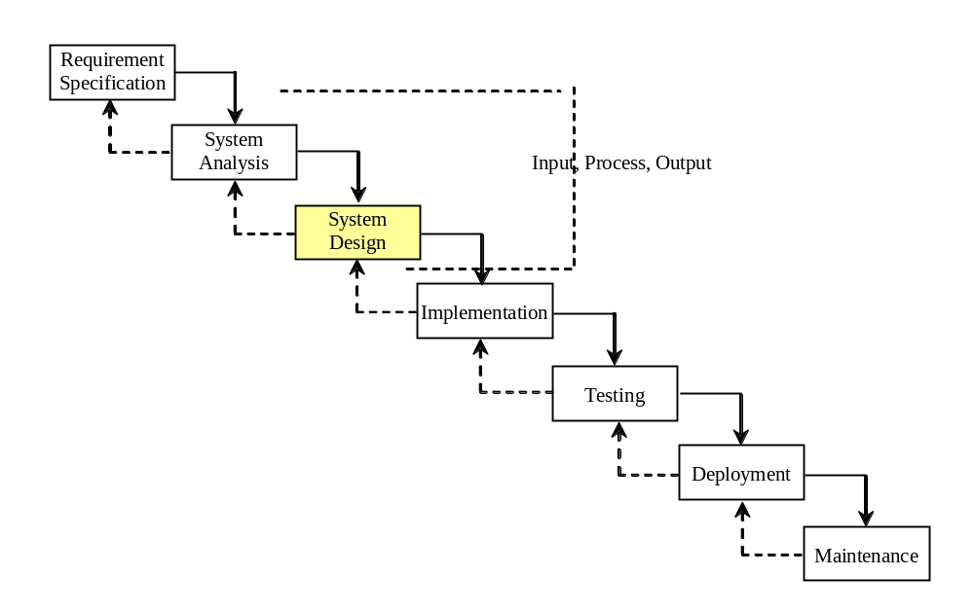
IPO
The essence of system analysis and design is input, process, and output. This is called IPO.

Slide 48
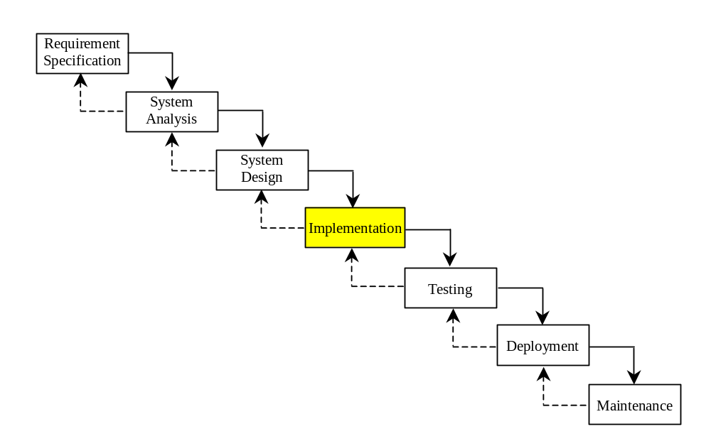
Implementation
The process of translating the system design into programs. Separate programs are written for each component and put to work together.
This phase requires the use of a programming language like Python. The implementation involves coding, testing, and debugging.

Slide 49
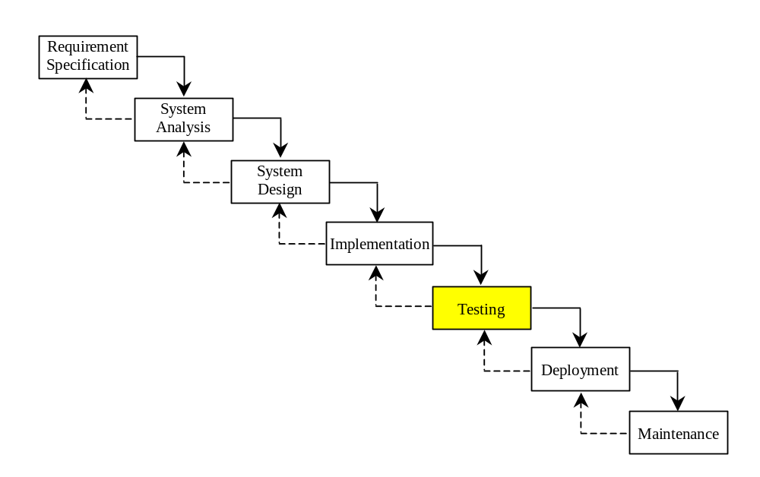
Testing
Ensures that the code meets the requirements specification and weeds out bugs.
An independent team of software engineers not involved in the design and implementation of the project usually conducts such testing.

Slide 50
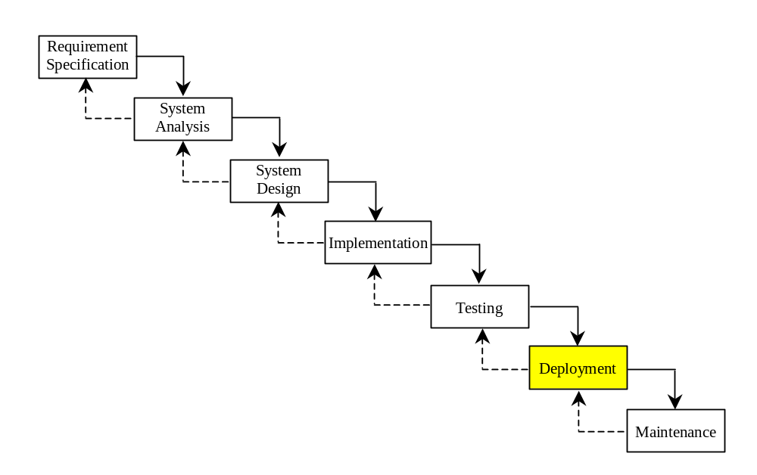
Deployment
Deployment makes the project available for use.

Slide 51
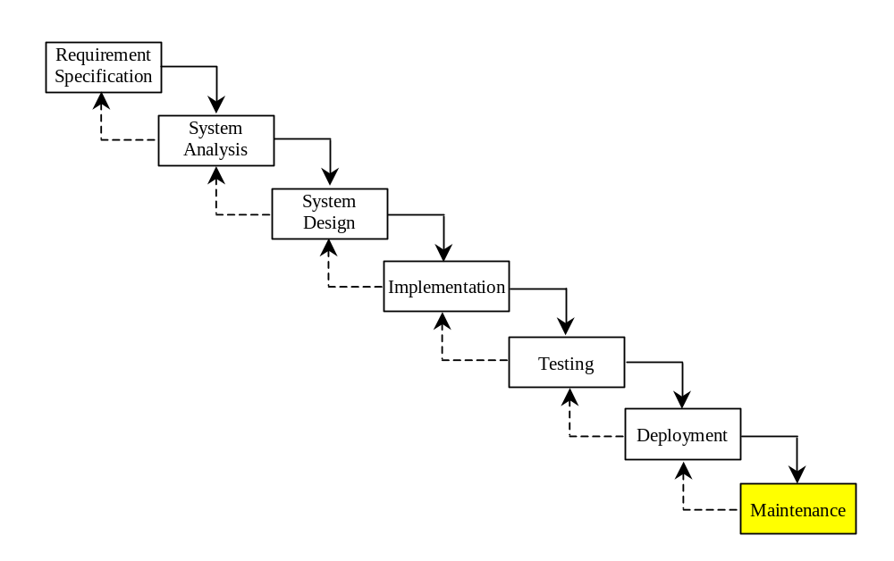
Maintenance
Maintenance is concerned with changing and improving the product.
A software product must continue to perform and improve in a changing environment. This requires periodic upgrades of the product to fix newly discovered bugs and incorporate changes.

Slide 52

Problem:
Computing Loan Payments
This program lets the user enter the interest rate, number of years, and loan amount, and computes monthly payment and total payment.
ComputeLoan
Run

Slide 53

Case Study: Computing Distances
This program prompts the user to enter two points, computes their distance, and displays the points.
ComputeDistance

Slide 54
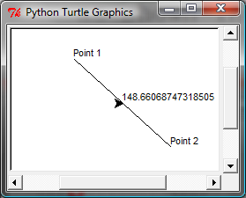
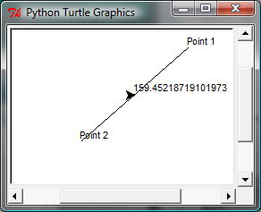
Case Study: Computing Distances
This program prompts the user to enter two points, computes their distance, and displays the points and their distances in graphics.
ComputeDistanceGraphics

